Slide 1







February 22, 2020
Microsoft Offices
Tampa, FL
Notes:
Philly text Requires this font: https://www.fontsquirrel.com/fonts/permanent-marker

Slide 2
Workflows to Flow Power Automate: Upgrade your Automation
Aiden Kaskela Tampa, FL 2020

Slide 3

Aiden Kaskela
President, Exalents Solutions
3x Business Applications MVP
Developing against Dynamics CRM / 365
for 14 years
Created Workflow Elements
Aiden.Kaskela@Exalents.com
@AidenKaskela

Slide 4
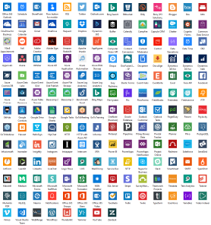
What is Flow? Trigger -> Action Current Connectors

Slide 5
Benefits of Flow over Classic Workflows
Overcome traditional limitations
Easily integrate with other services
Continually receive new features

Slide 6
Objectives
How to configure Flow triggers
How to perform actions that mimic Workflow steps
Current limitations of Flow
Cool stuff you can do in Flow that Classic Workflows can’t

Slide 7

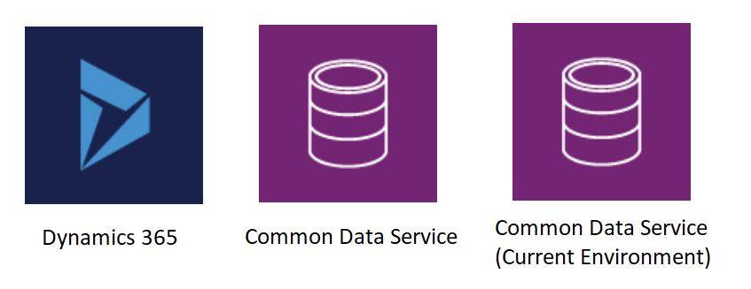


Connectors

Slide 8
Different ways to Create Flows
From your Model Driven App (okay)
From the Power Automate site – My Flows (better)
From a solution (best)

Slide 9
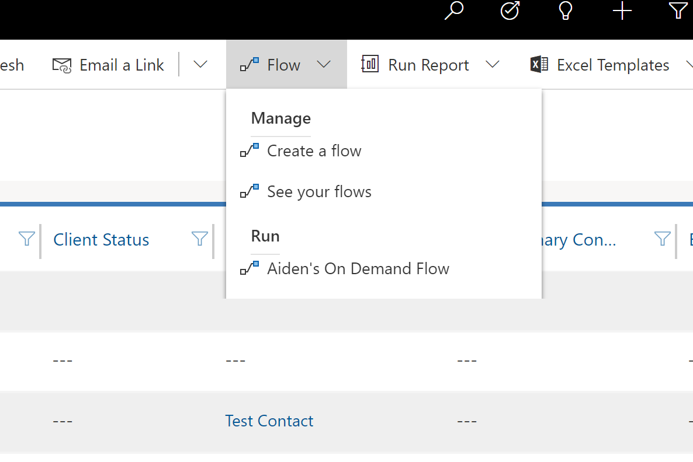
From a Model Driven App On Demand Only

Slide 10
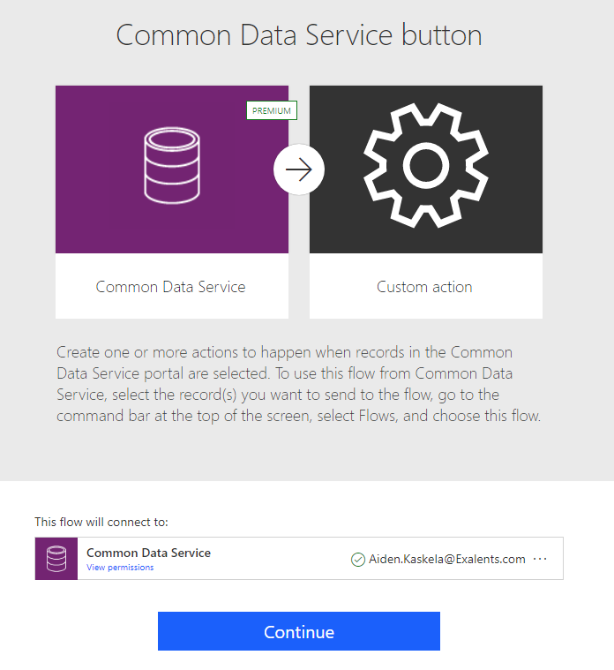
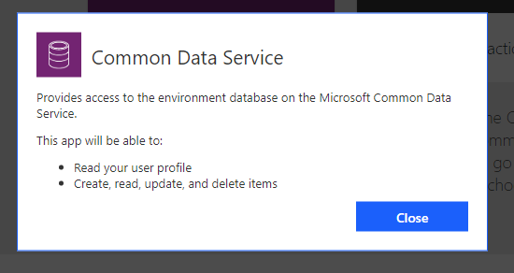
On Demand Flow – Security

Slide 11
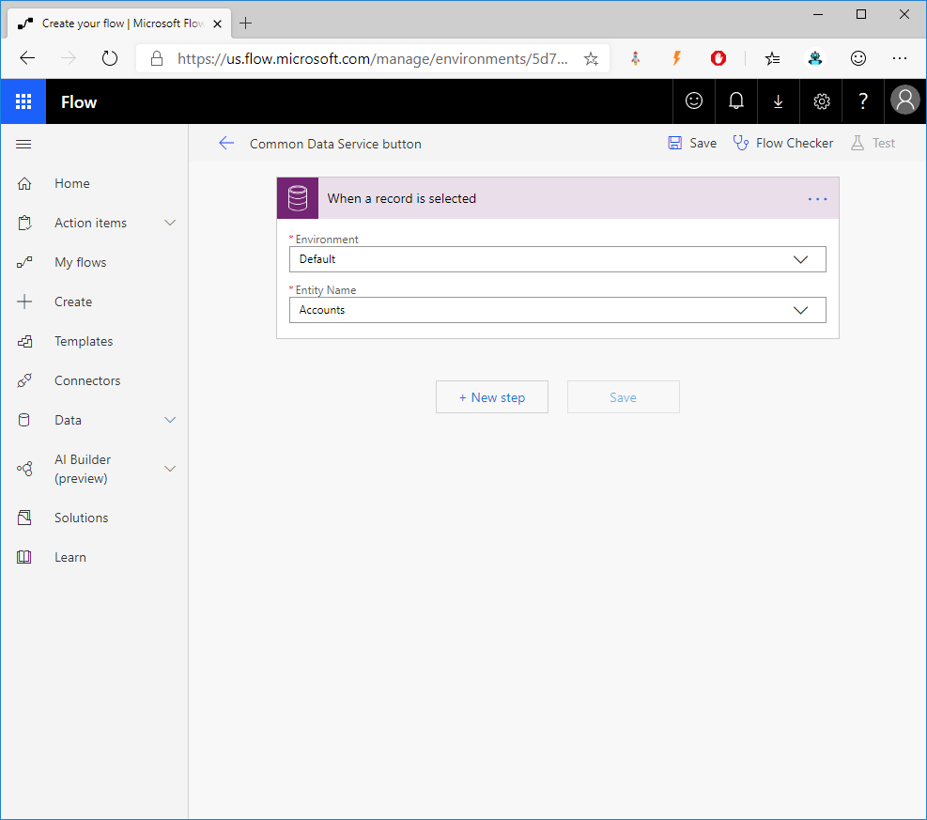
From Model Driven - On Demand Trigger: When a record is selected

Slide 12
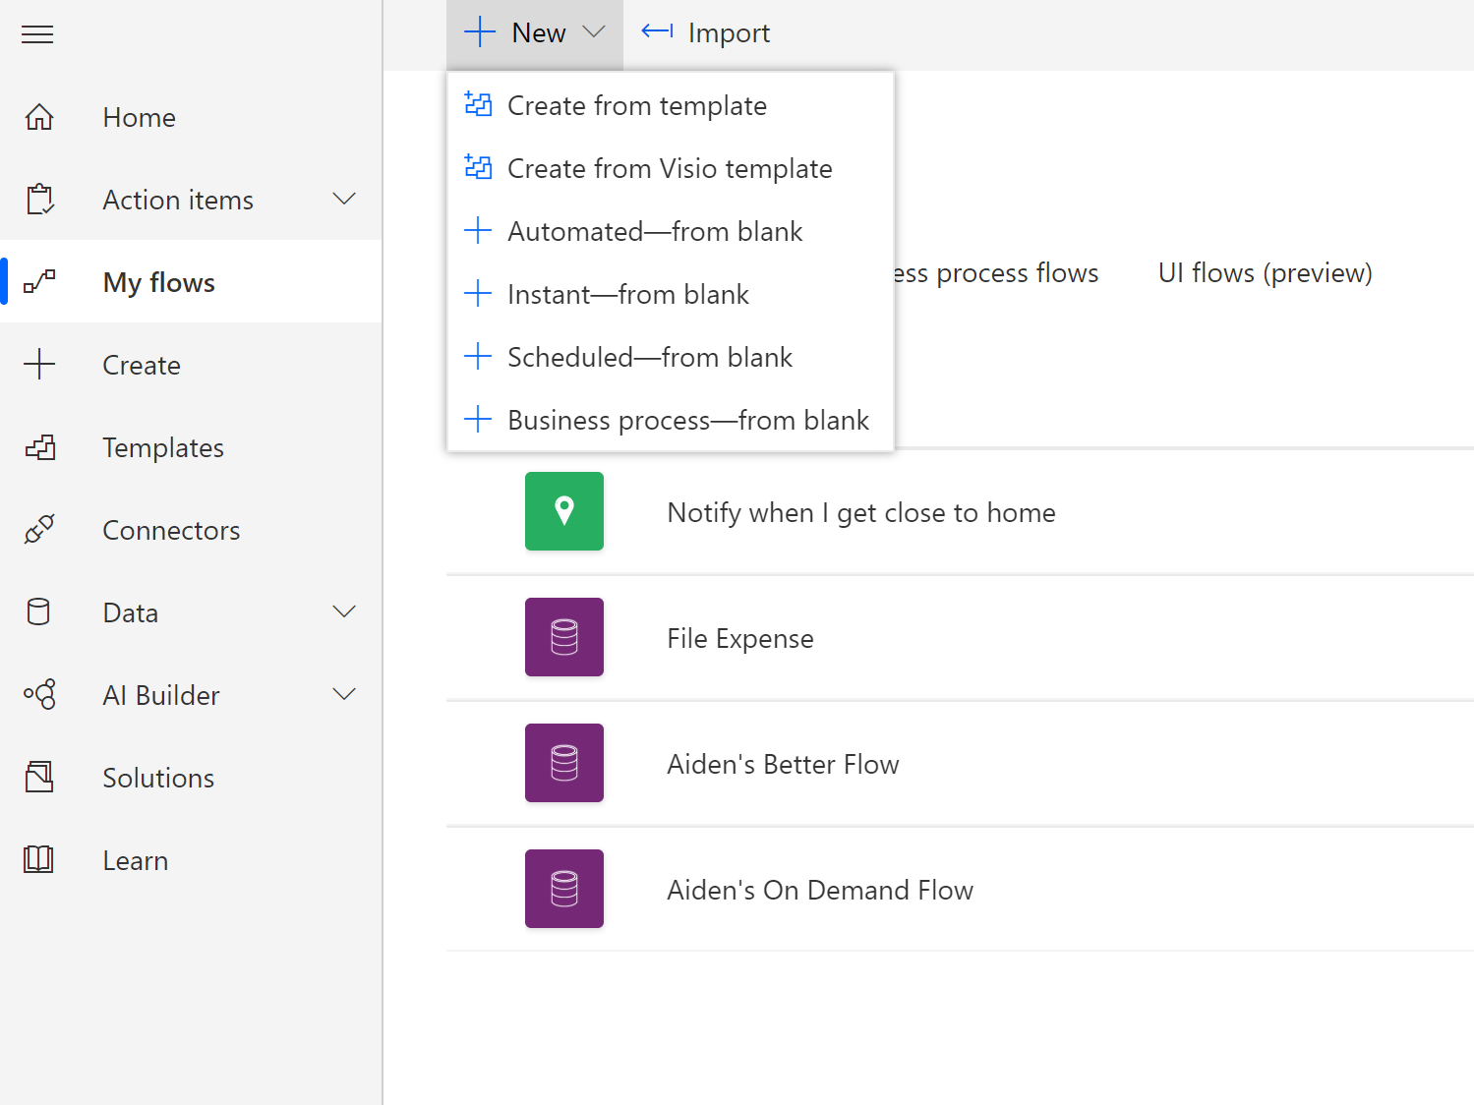
My Flows (better) My Flows -> New Flow

Slide 13
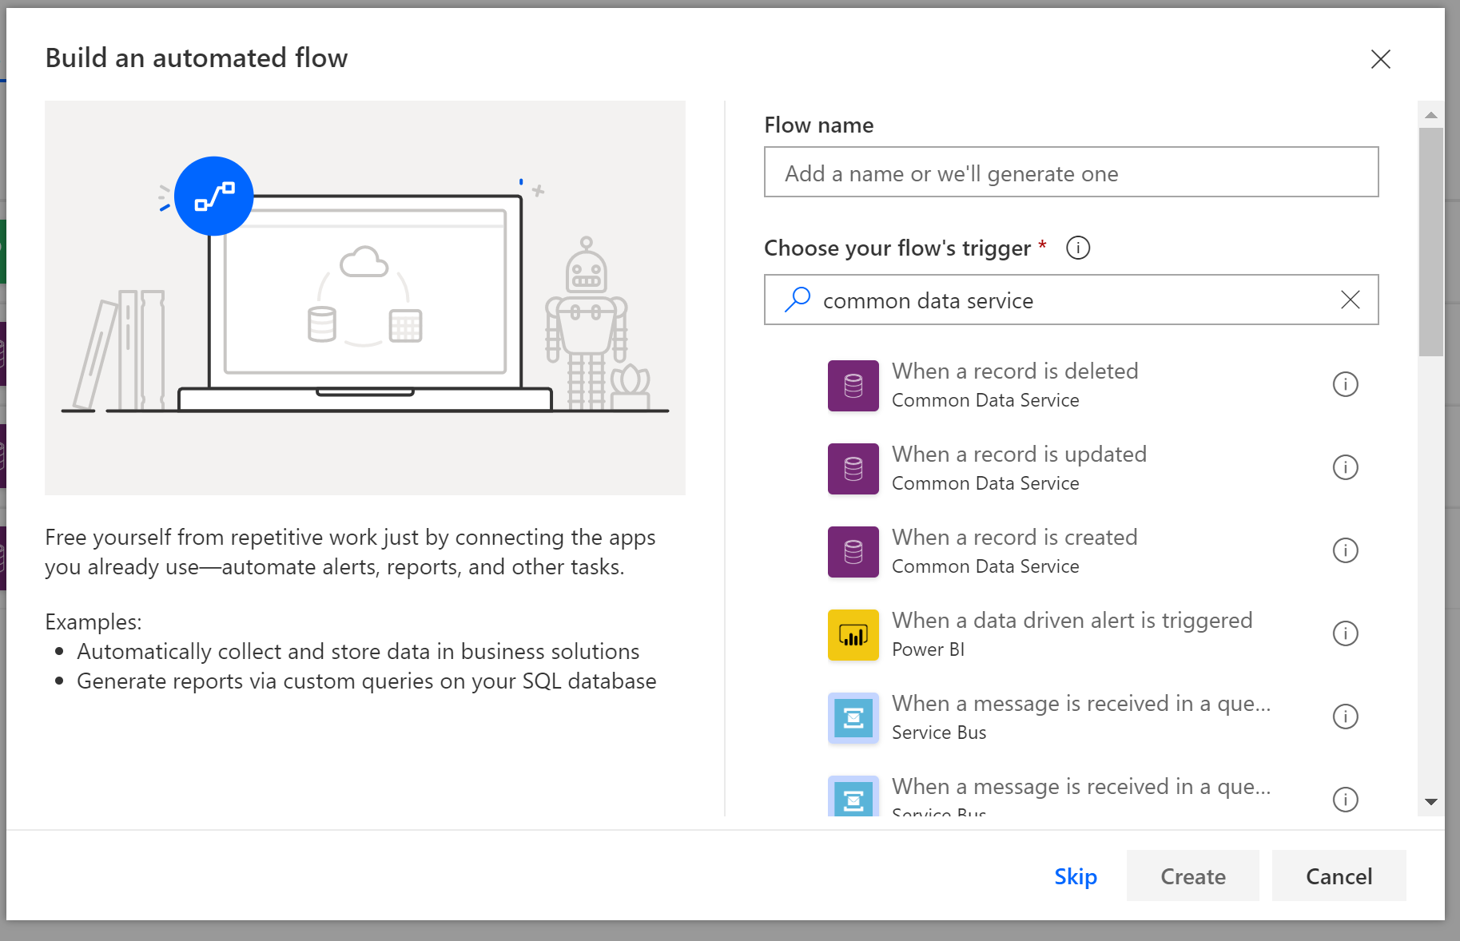
My Flows (better) Where’s the Trigger?

Slide 14
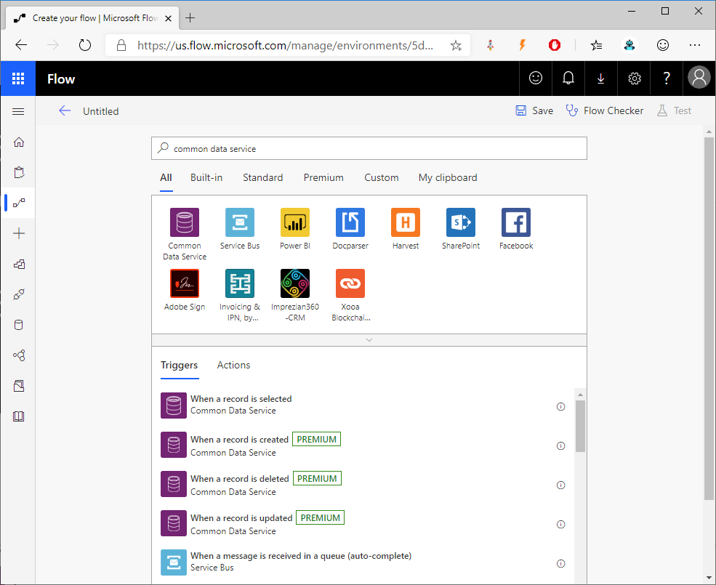
My Flows (better) There it is!

Slide 15
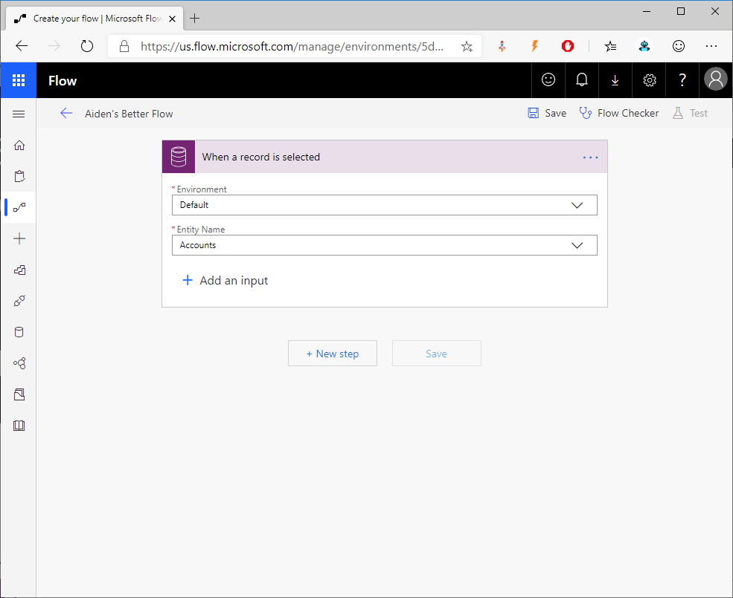
My Flows (better) Input!

Slide 16
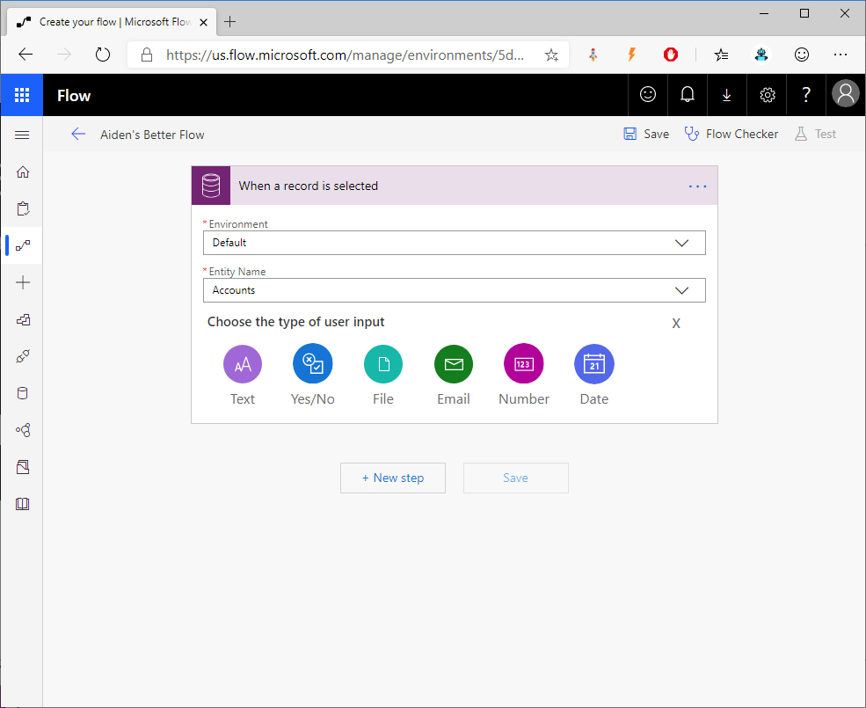
My Flows (better) Input!

Slide 17
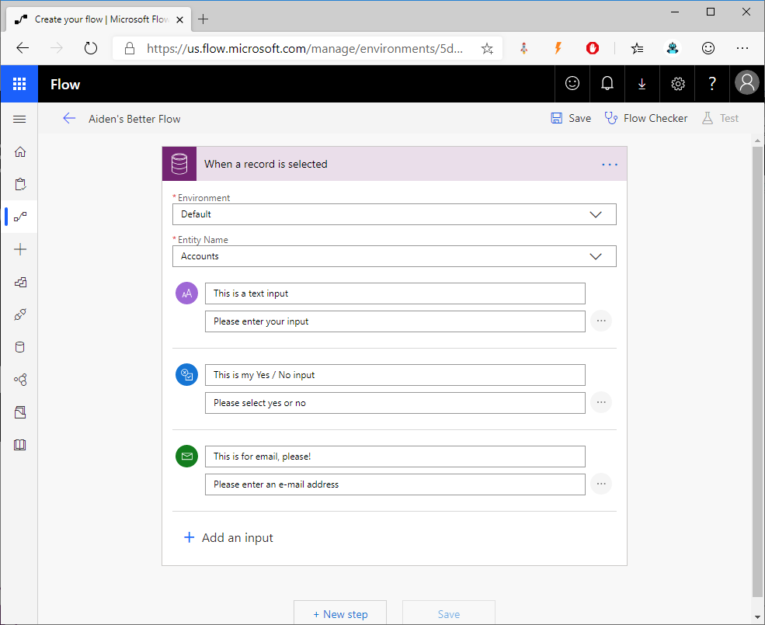
My Flows (better) Input!

Slide 18
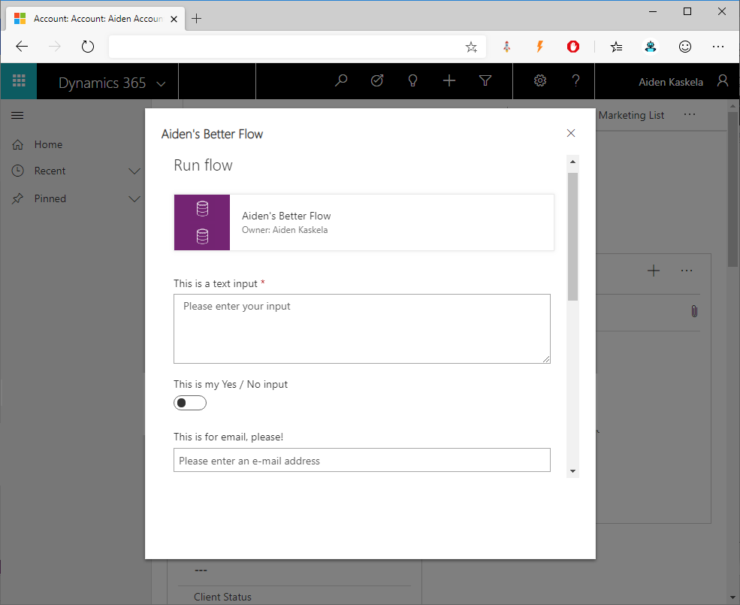
My Flows (better) Input!

Slide 19
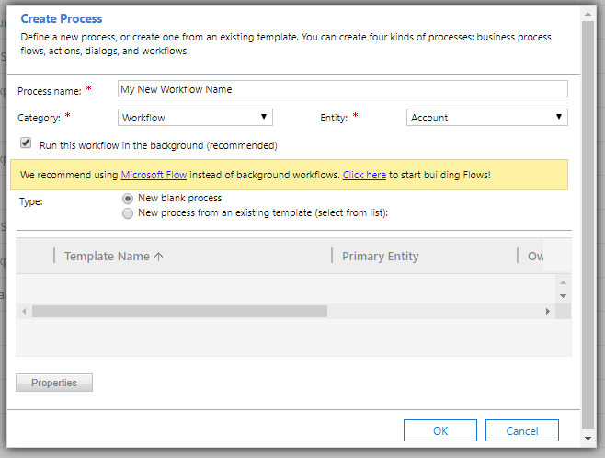
Solution (best) – Workflow Recap

Slide 20
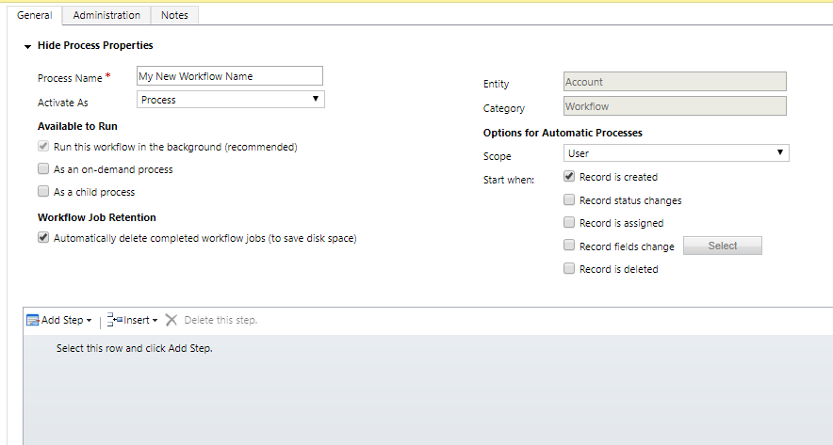
Solution (best) – Workflow Recap

Slide 21
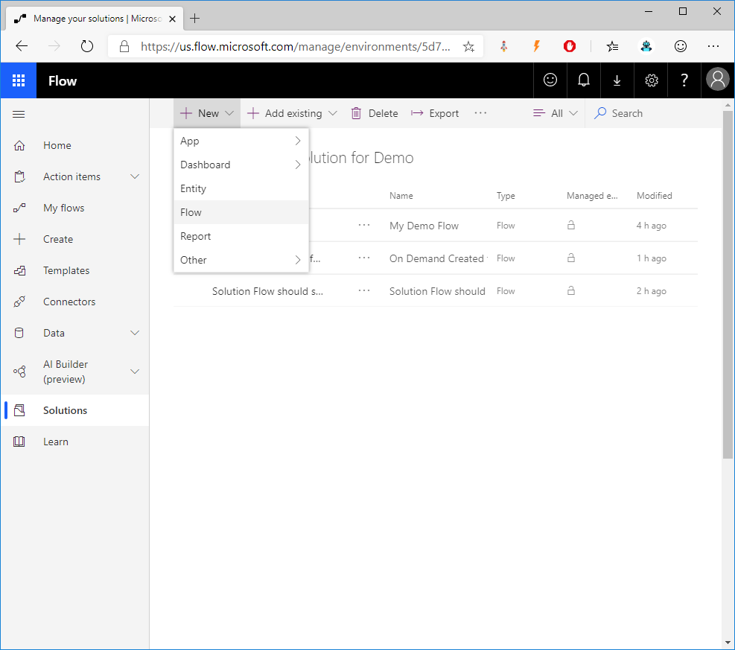
Solution (best) Adding a new Flow

Slide 22
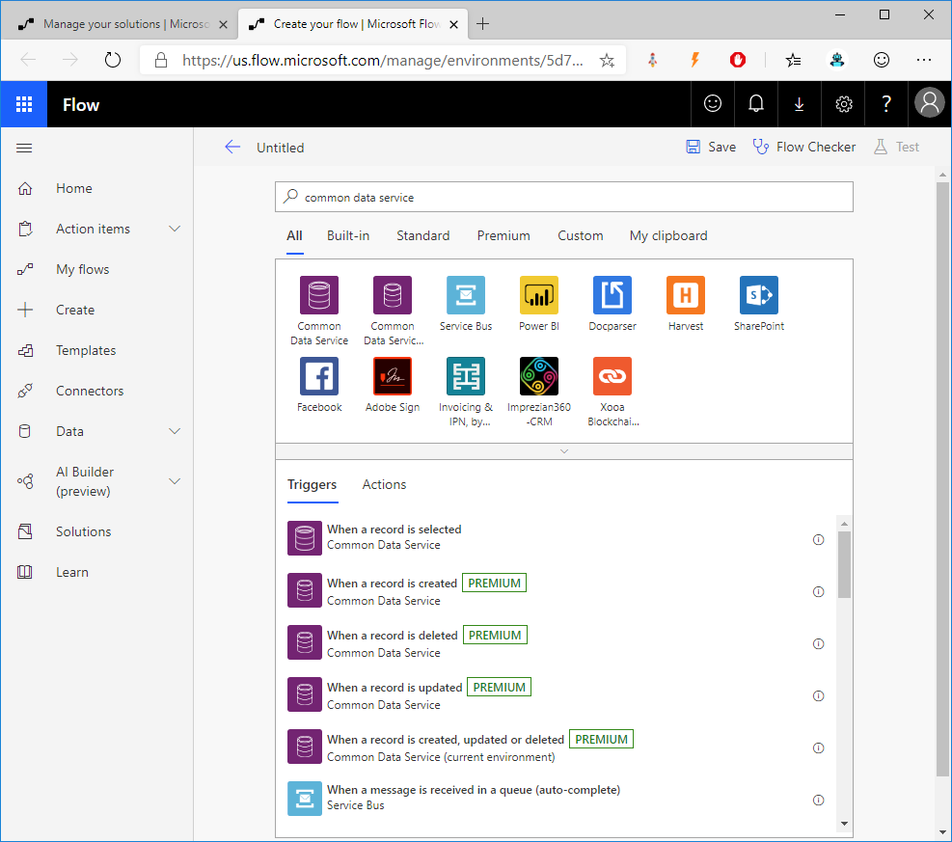
Solution (best) The Trigger

Slide 23
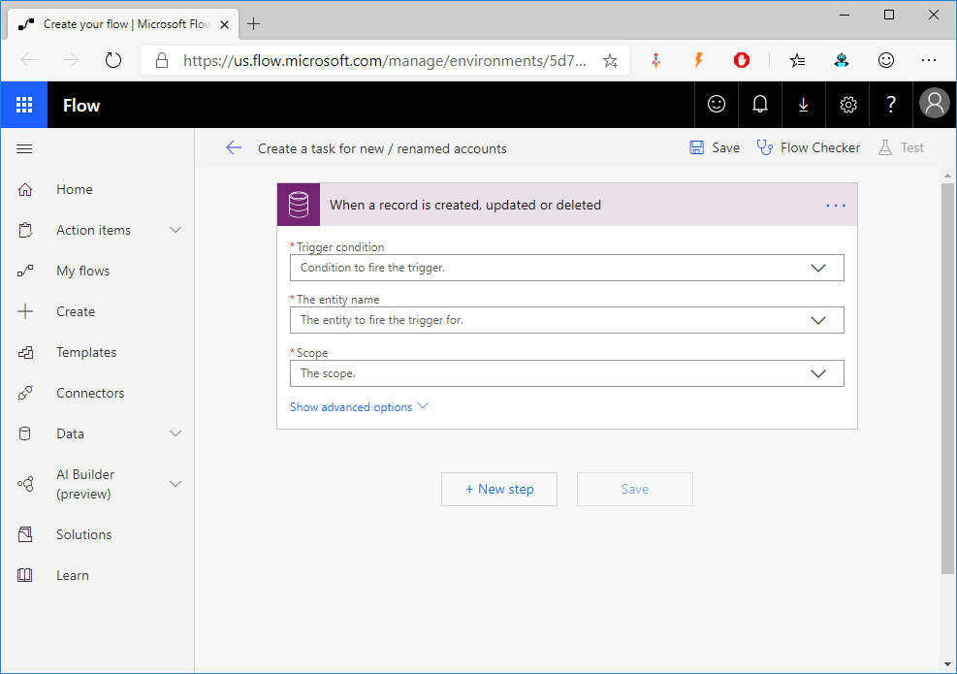
Solution (best) The Trigger

Slide 24
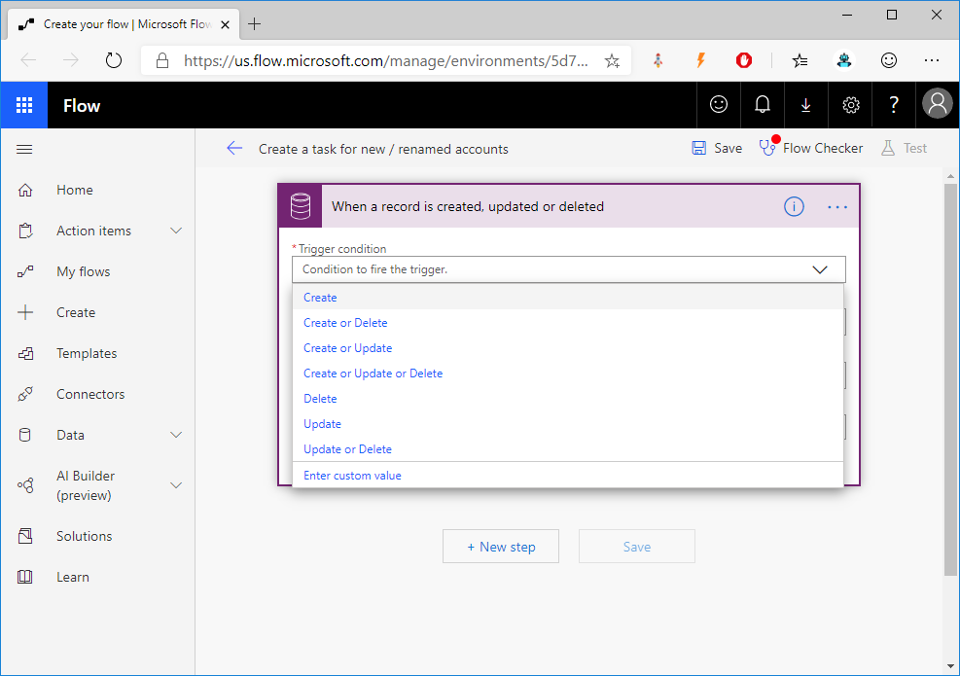
Solution (best) The Trigger

Slide 25
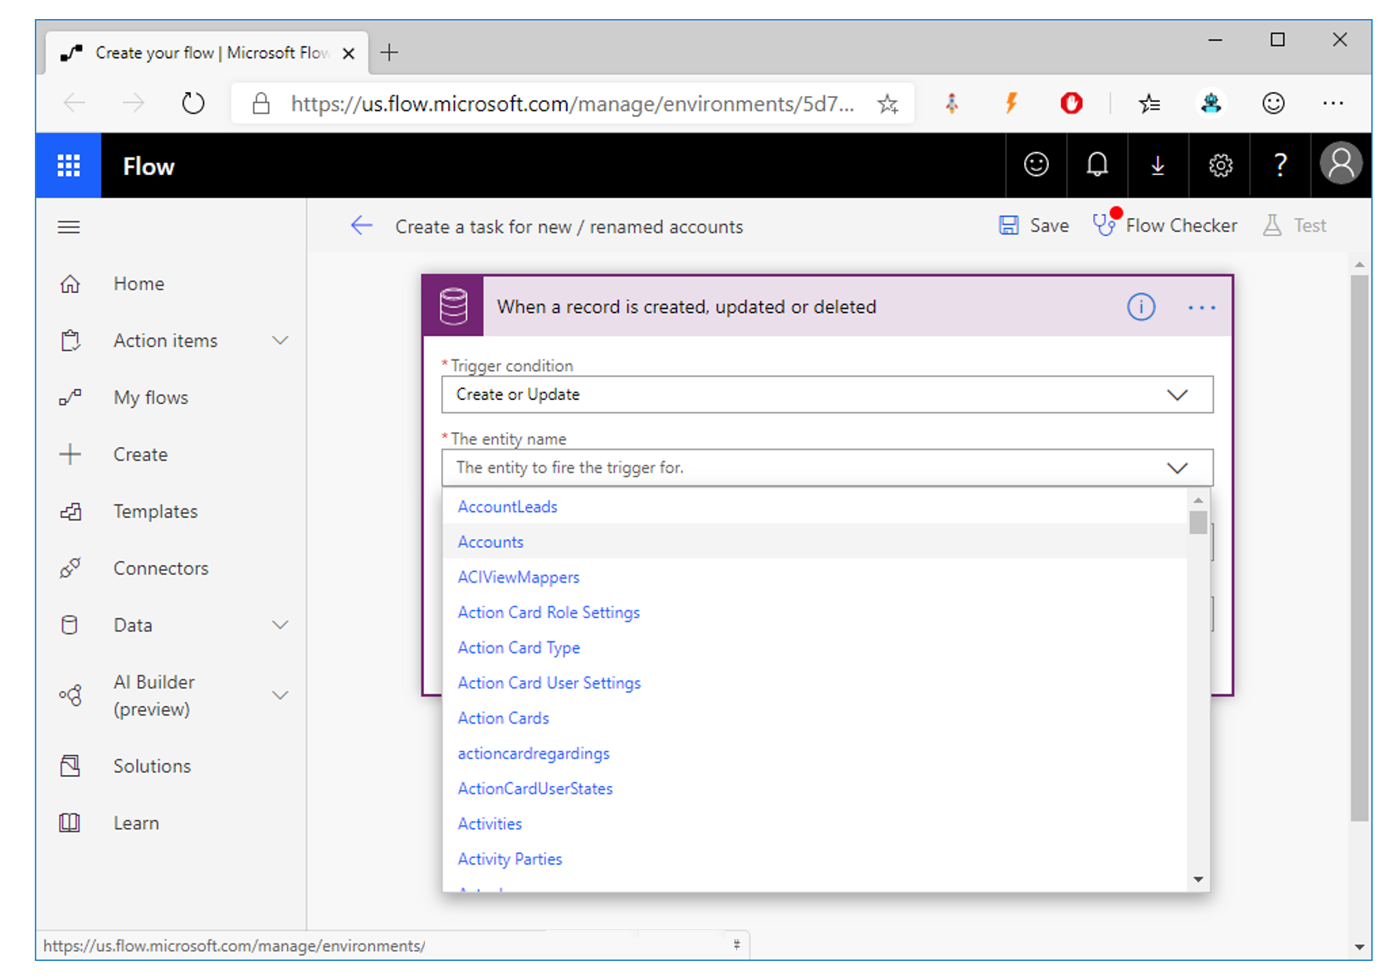
Solution (best) The Trigger

Slide 26
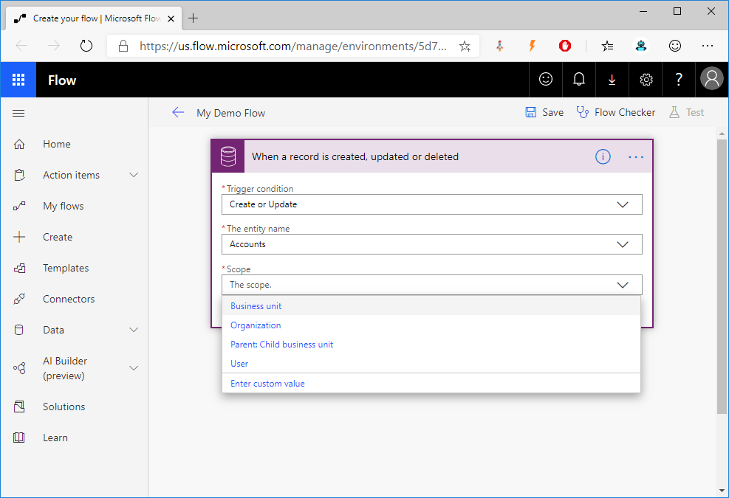
Solution (best) The Trigger

Slide 27
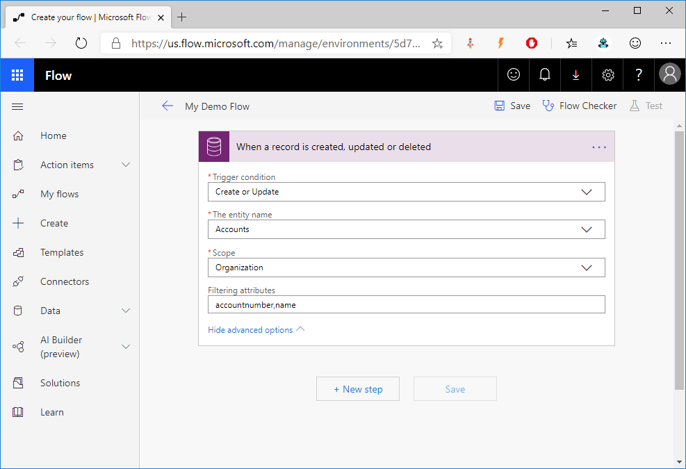
Solution (best) The Trigger

Slide 28
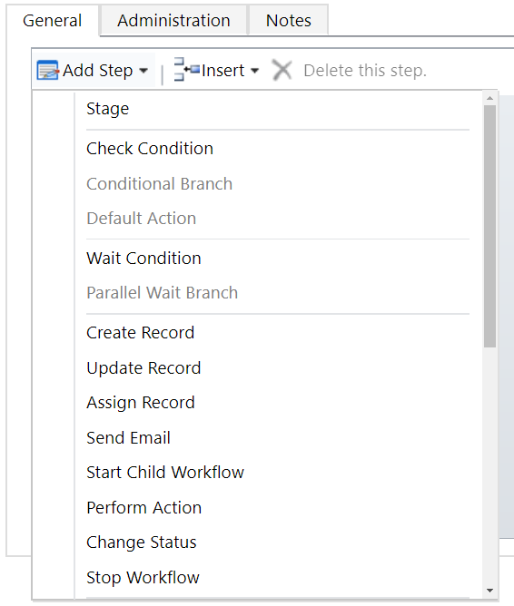
Classic Workflows Steps

Slide 29
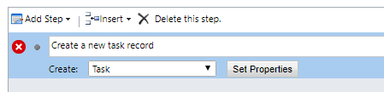
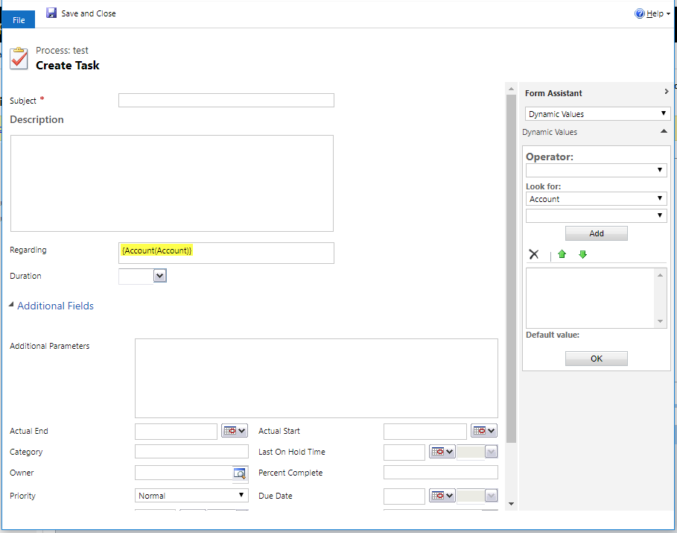
Classic Workflows Create

Slide 30
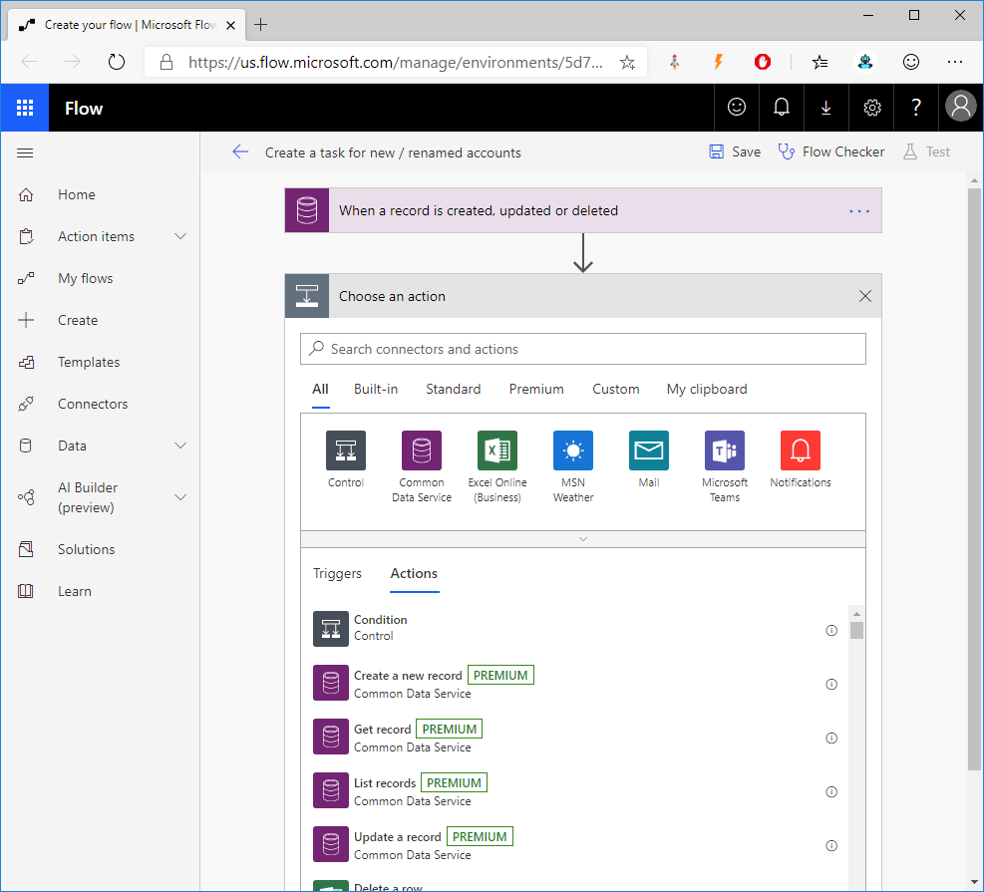
Flow Create Action

Slide 31
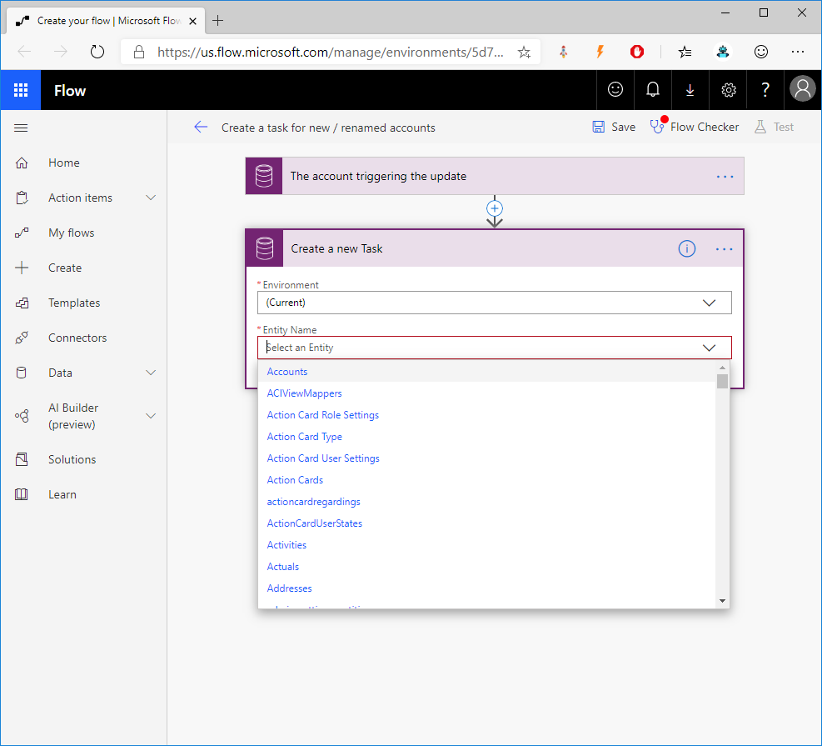
Flow Select the Entity

Slide 32
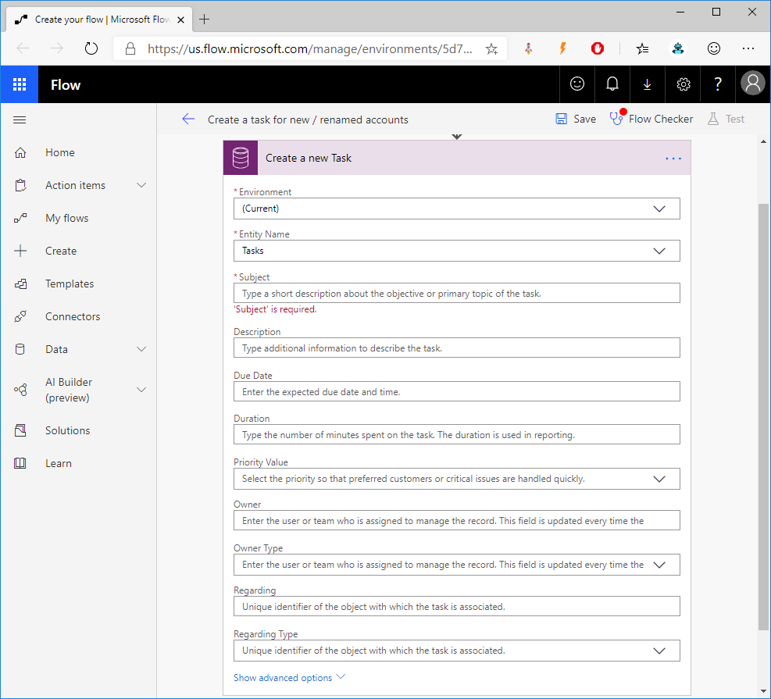
Flow Set any Properties

Slide 33
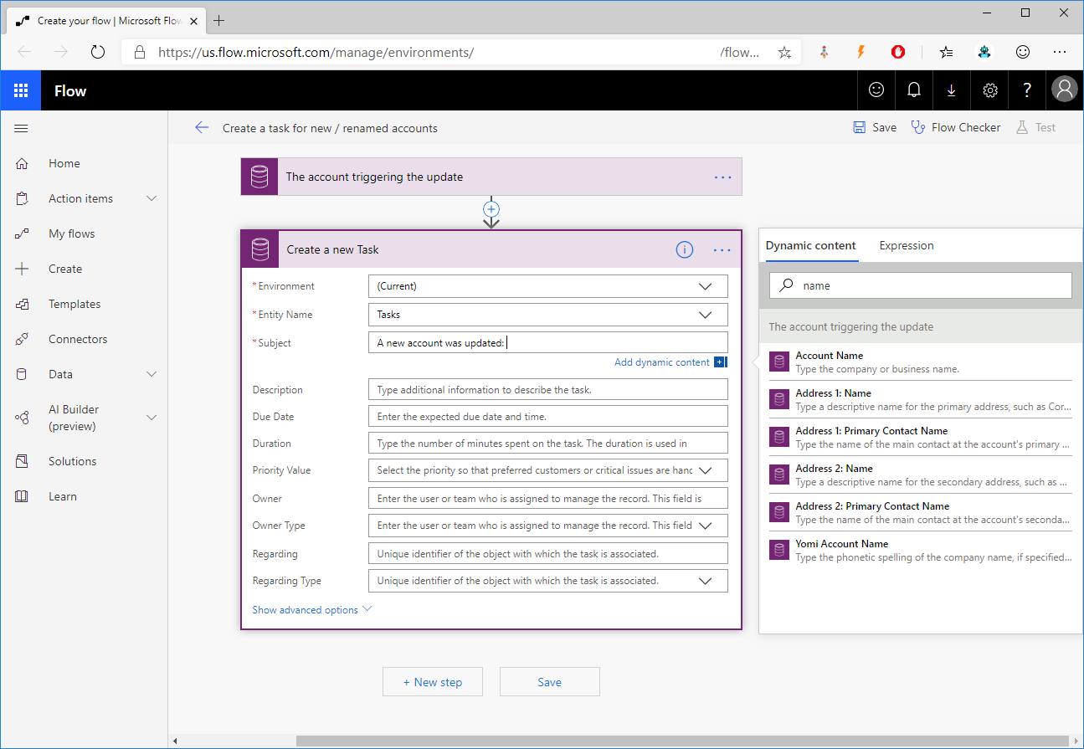
Flow Dynamic values

Slide 34
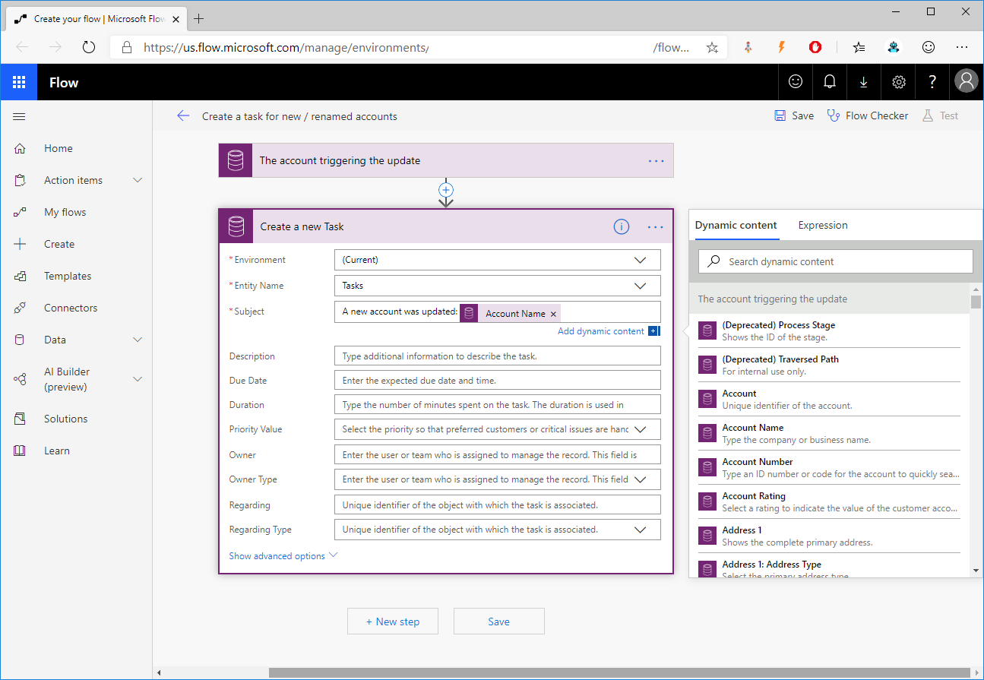
Flow Dynamic values

Slide 35
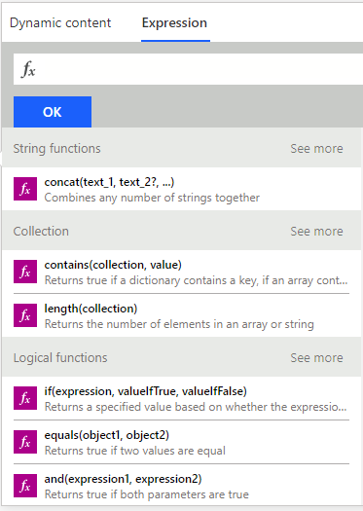
Flow Expressions

Slide 36
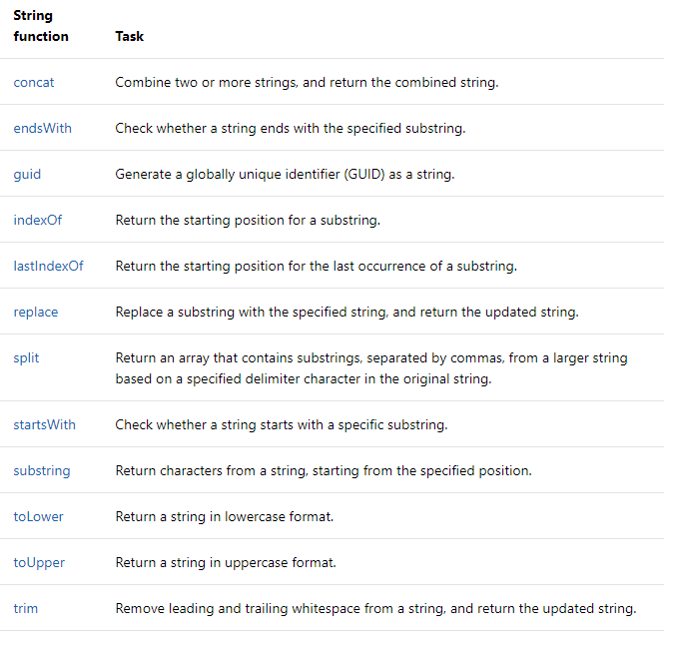
Flow Expressions

Slide 37
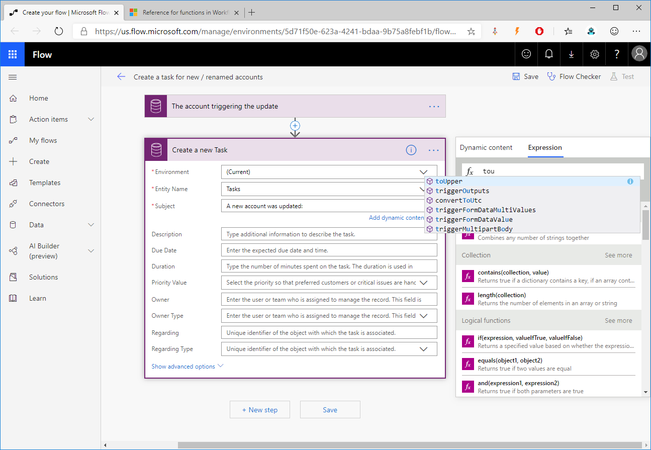
Flow Dynamic values

Slide 38
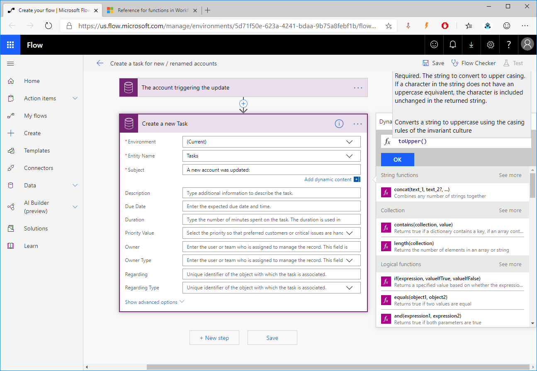
Flow Dynamic values

Slide 39
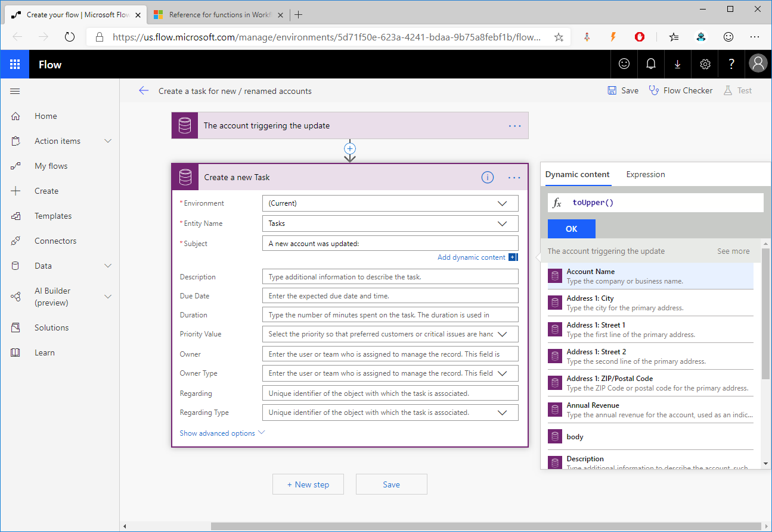
Flow Dynamic values

Slide 40
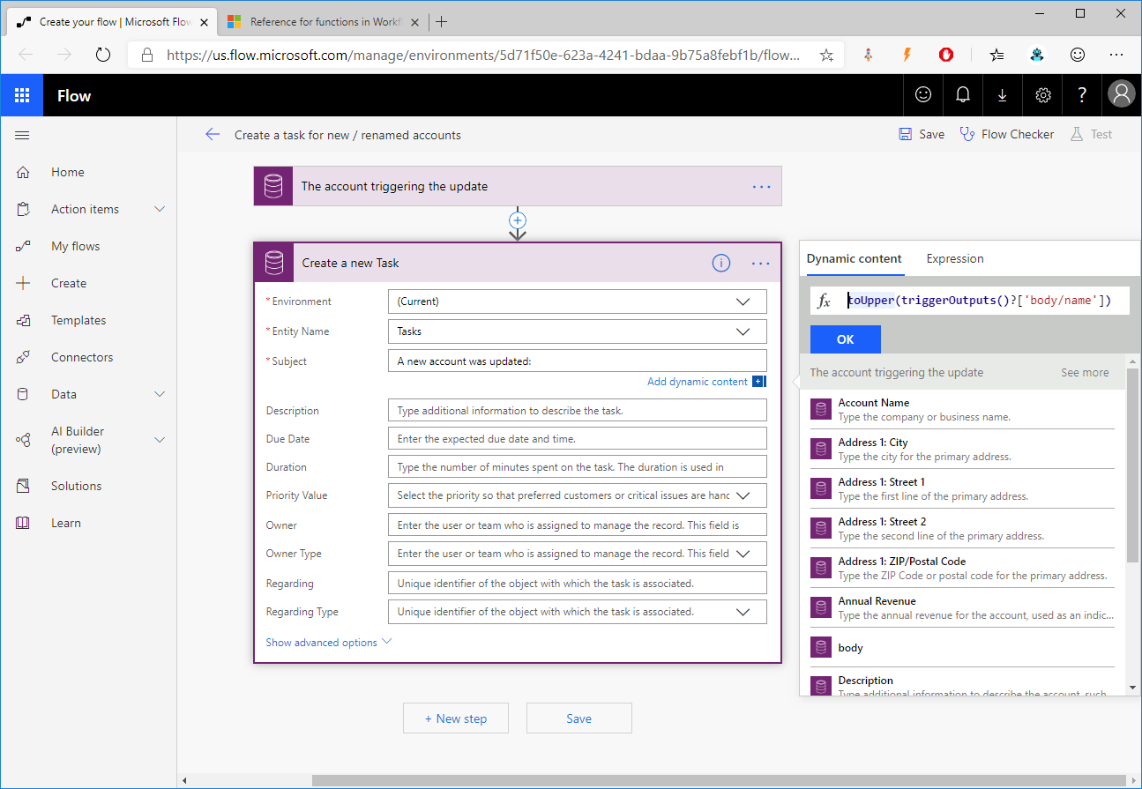
Flow Dynamic values

Slide 41
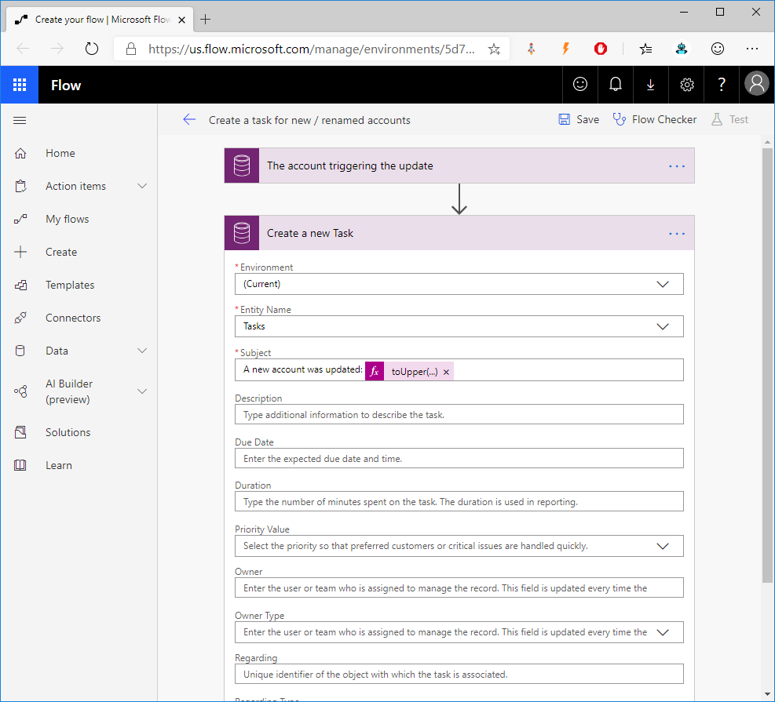
Flow Set any Properties

Slide 42
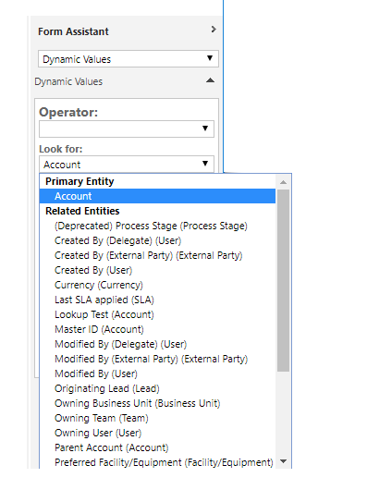
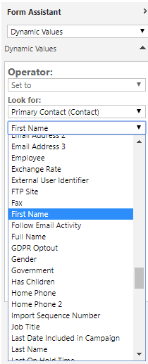
Classic Workflows Info from related records

Slide 43
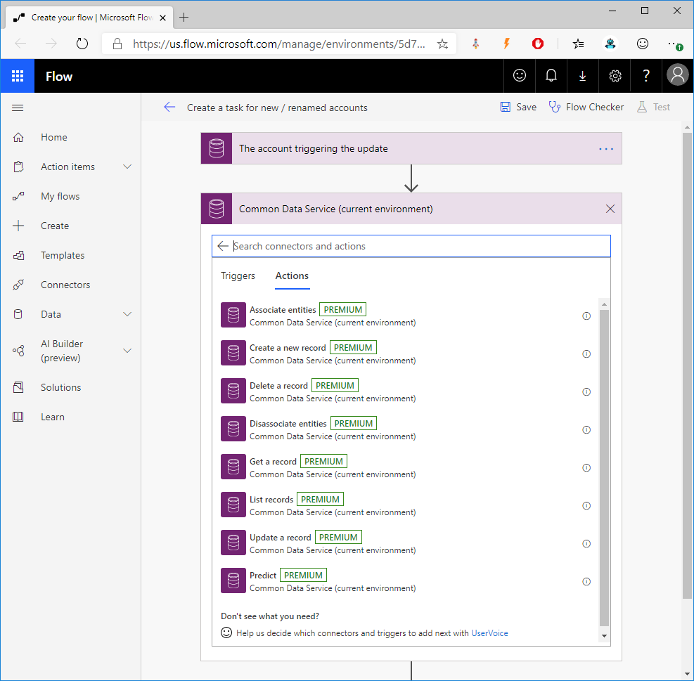
Flow Info from related records

Slide 44
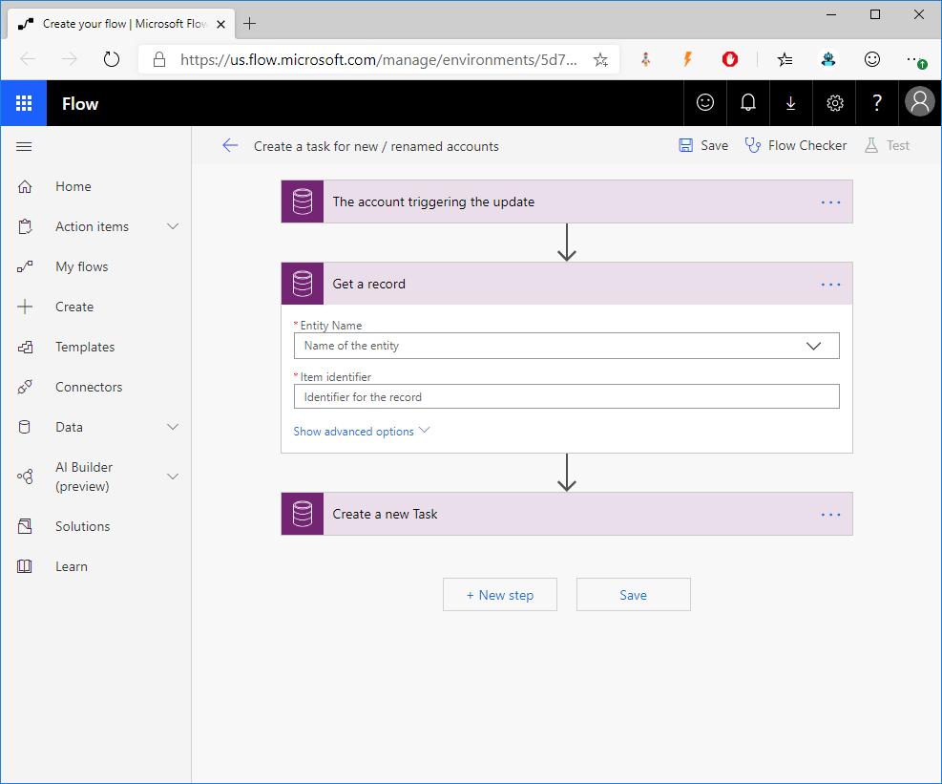
Flow Info from related records

Slide 45
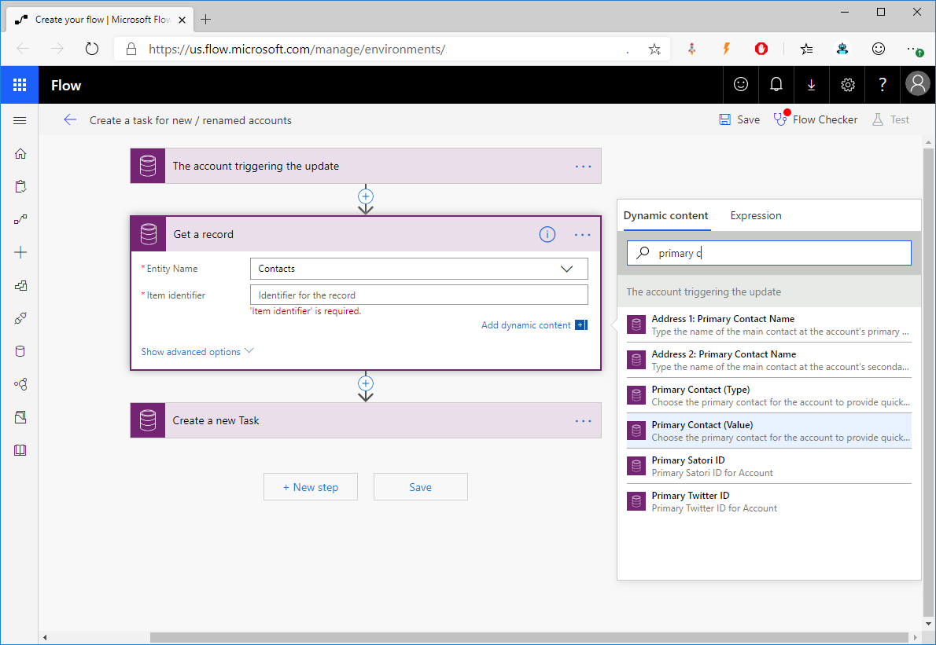
Flow Info from related records

Slide 46
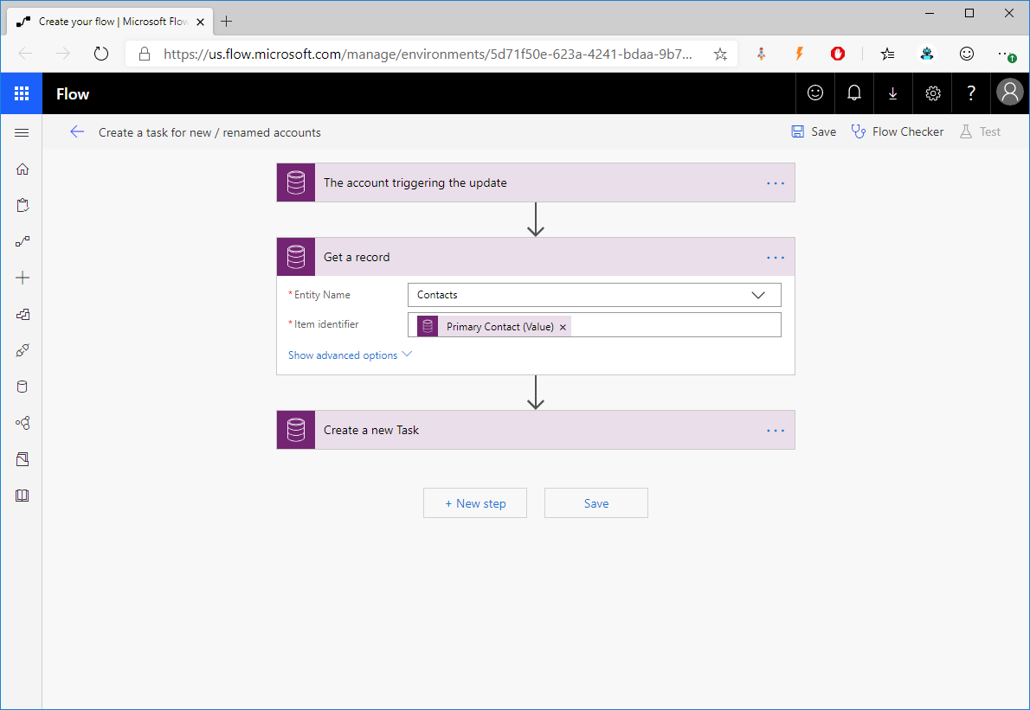
Flow Info from related records

Slide 47
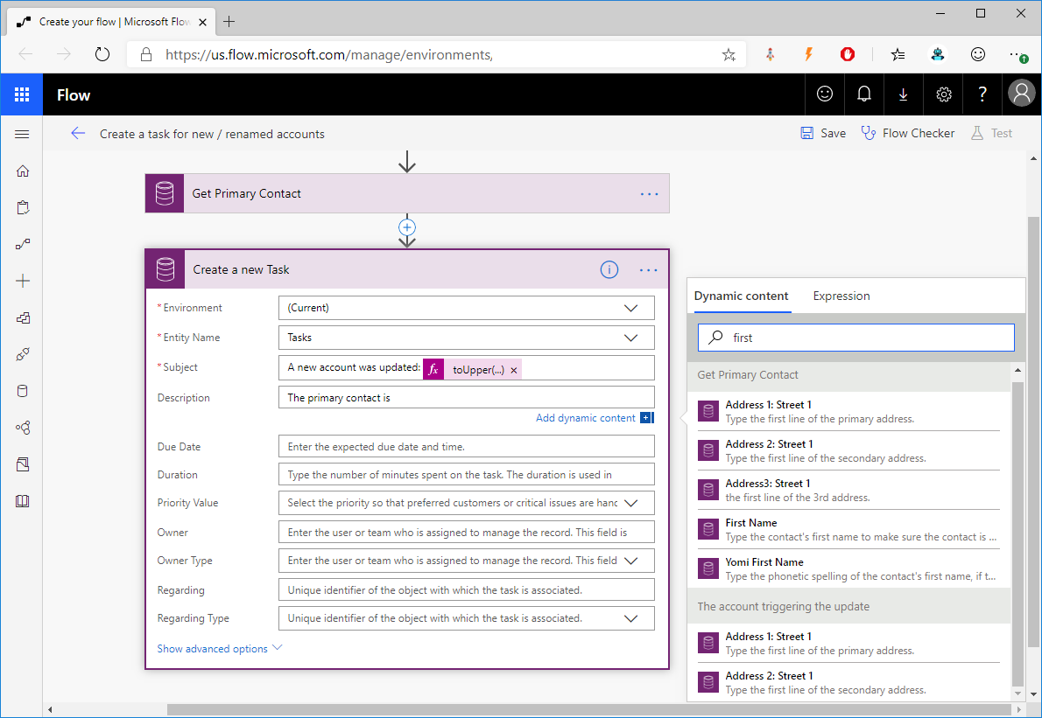
Flow Info from related records

Slide 48
Classic Workflows Steps

Slide 49
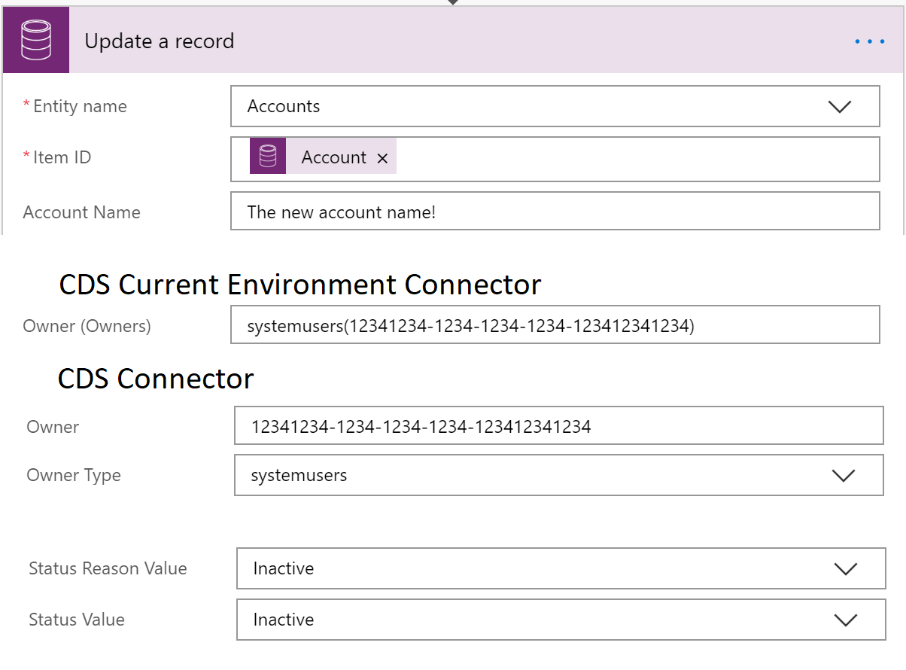
Flow Update records

Slide 50
Classic Workflows Steps

Slide 51
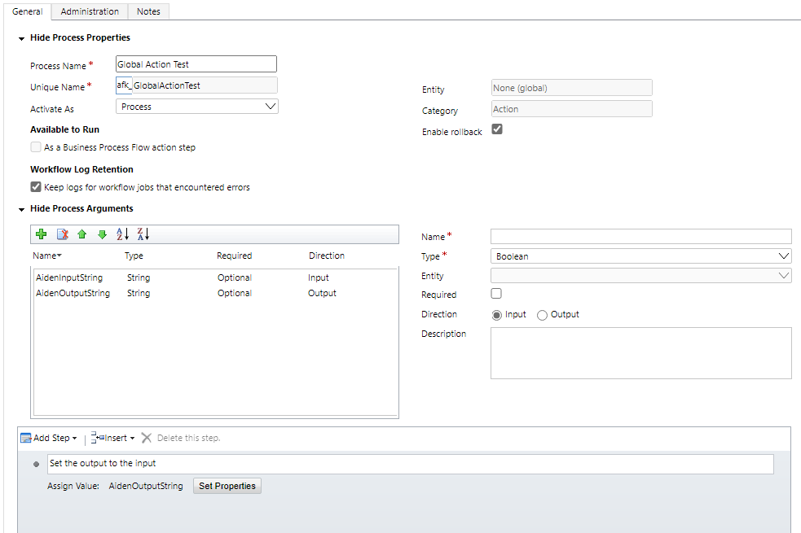
Classic Workflows Actions (Global)

Slide 52
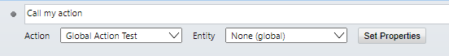
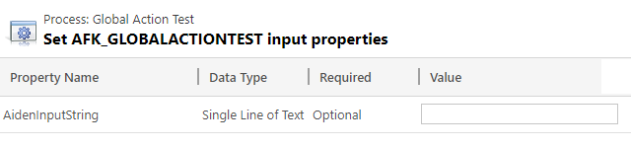
Classic Workflows – Call an Action

Slide 53
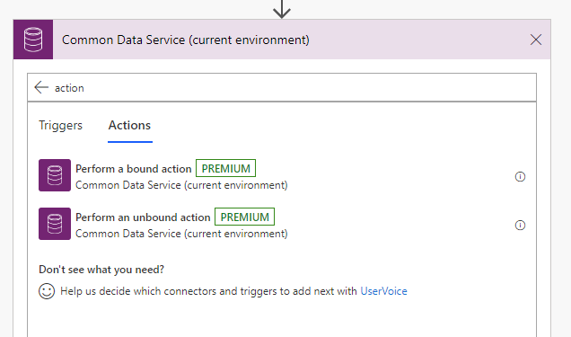
Flow Actions

Slide 54
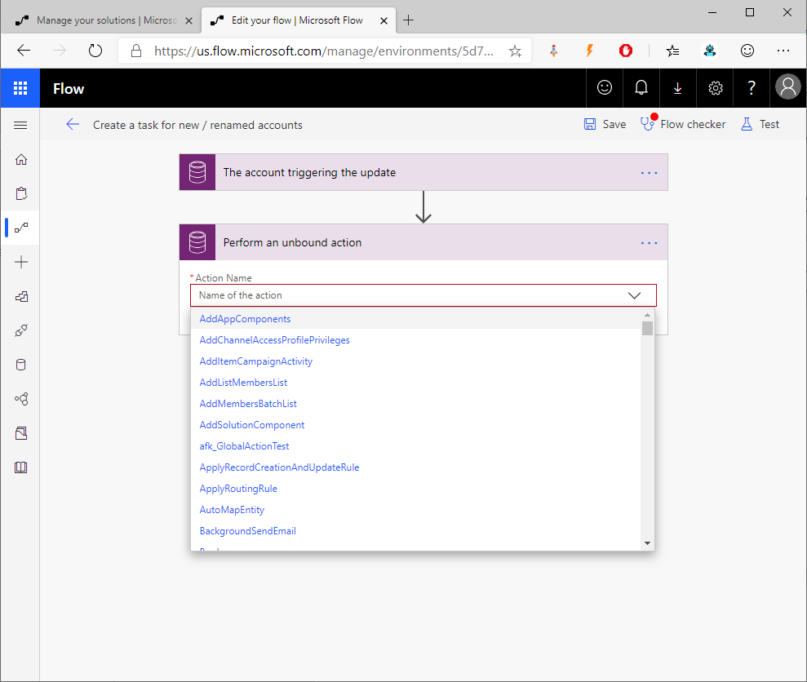
Flow Unbound Actions

Slide 55

Flow Unbound Actions

Slide 56

Flow Bound Actions

Slide 57
Classic Workflows Steps

Slide 58

Flow Control “connector”

Slide 59

Flow – Condition

Slide 60

Flow – Condition

Slide 61

Flow – Switch

Slide 62

Flow – Switch

Slide 63
Classic Workflows Steps

Slide 64

What else? Custom Code

Slide 65

Flow Real-Time?

Slide 66

Flow What’s new? Delete

Slide 67


Flow What’s new? Predict

Slide 68


Flow What’s new? Predict

Slide 69

Flow What’s new? Relate & Unrelate

Slide 70

Flow What’s new? Query

Slide 71

Flow What’s new? Upload & Get Files

Slide 72

Flow What’s new? Change set

Slide 73

Flow What’s new? Scheduling

Slide 74

Thank you ClickDimensions being a platinum sponsor
February 22, 2020
Microsoft Offices
Tampa, FL
Notes:
Philly text Requires this font: https://www.fontsquirrel.com/fonts/permanent-marker

Slide 75
References and more information
Replace classic Common Data Service workflows with flows
https://docs.microsoft.com/en-us/flow/replace-workflows-with-flows
What's new and planned for Microsoft Flow (October 2019 through March 2020)
https://docs.microsoft.com/en-us/power-platform-release-plan/2019wave2/microsoft-flow/planned-features
CDS Connector
https://docs.microsoft.com/en-us/Connectors/commondataserviceforapps/
On Premise Data Gateway
https://docs.microsoft.com/en-us/flow/gateway-reference
Functions in Flow
https://docs.microsoft.com/en-us/azure/logic-apps/workflow-definition-language-functions-reference#functions-in-expressions
Calling a CDS Action from Flow
https://docs.microsoft.com/en-us/business-applications-release-notes/april19/microsoft-flow/automated-flows-call-common-data-service-action
Aiden.Kaskela@Exalents.com
@AidenKaskela

